Slide 1

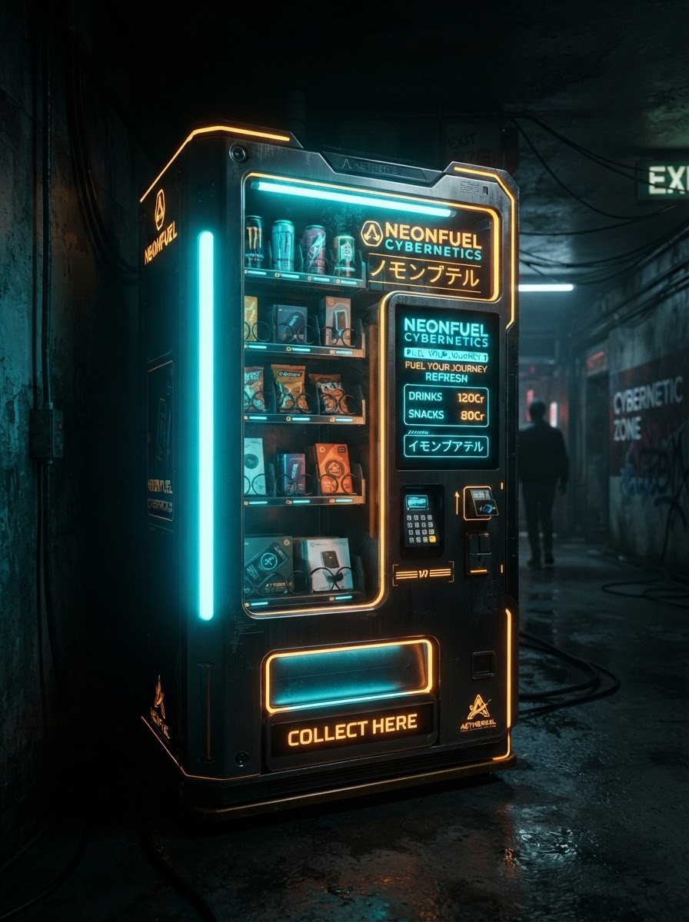

ACADEMIC PROJECT PRESENTATION
Vending Machine Controller Simulator
Charan — 2620090125
Dheeraj — 2620030472
Faculty Guide: Gopi Krishna

Slide 2
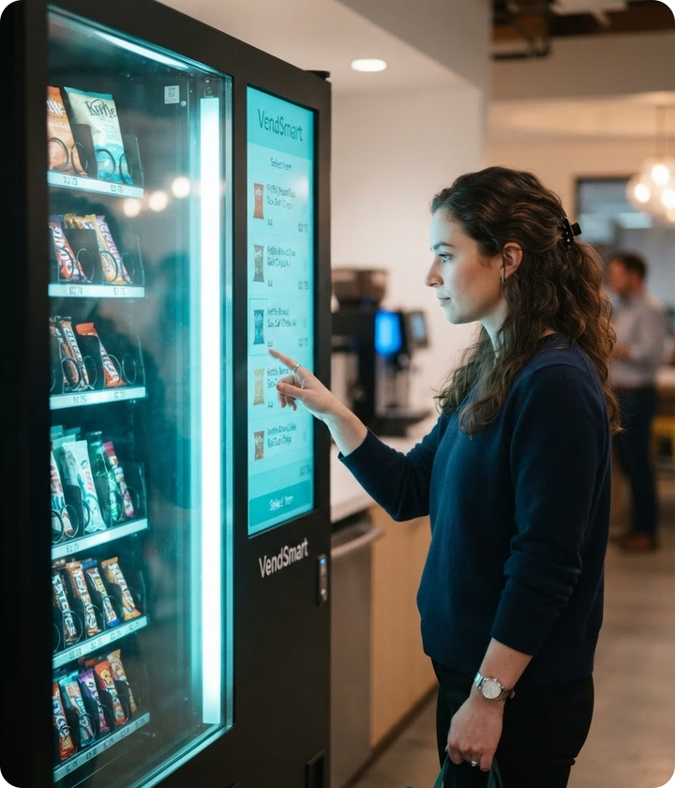
01
Introduction
A software model of the logic that runs a real vending machine: coin input, product selection, dispensing and change return.
Built in Java to demonstrate finite state machine concepts in a hands-on way.
Relevant to embedded systems, automation and cashless retail, where reliable controller logic is critical.

Slide 3

02 — THE PROBLEM
Problem Statement
Hardware-bound logic is costly and hard to test before deployment.
Coins get stuck or incorrect change is returned.
Poor handling of out-of-stock items and invalid inputs.
No safe environment for students to study controller behaviour.
Limited feedback and user-unfriendly interfaces.
Why current machines frustrate users and operators

Slide 4

Objectives
Four goals that shaped the simulator
01
Model vending logic as a clear finite state machine
02
Handle coins, selection, dispensing and change accurately
03
Provide an intuitive, interactive user interface
04
Enable safe testing without physical hardware

Slide 5
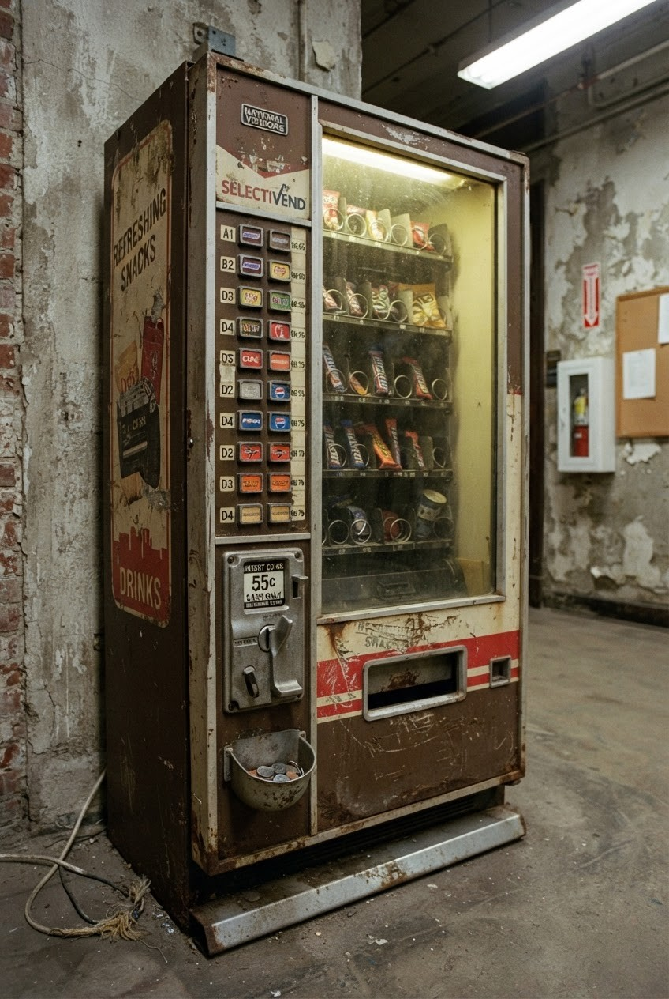
04 — CURRENT STATE
Existing System
Most machines use microcontroller firmware or mechanical coin validators with fixed, hard-coded logic.
LIMITATIONS
Difficult to modify or update
Testing requires physical hardware
Weak error and refund handling
No visual insight into internal states

Slide 6



Proposed System
A Java-based, state-driven simulator that reproduces real controller behaviour in software.
Flexible
Reliable
Transparent
Products, prices and rules are changed in code, no hardware rewiring needed.
Validates every input, returns exact change and refunds on cancel.
Shows current state and transactions live, ideal for learning and testing.

Slide 7


System Architecture
Input Module
State Controller
Output Module
Accepts coins and product selections from the user interface.
Finite state machine: Idle → Coin Inserted → Selected → Dispensing.
Dispenses product, returns change and updates inventory records.

Slide 8
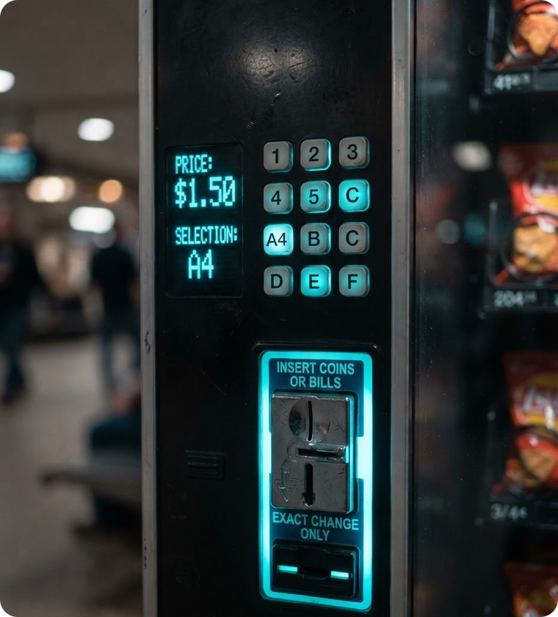
Functionalities
Coin insertion with value validation
Product selection with price check
Automatic product dispensing
Exact change calculation
Cancel and full refund option
Stock tracking with out-of-stock alerts

Slide 9
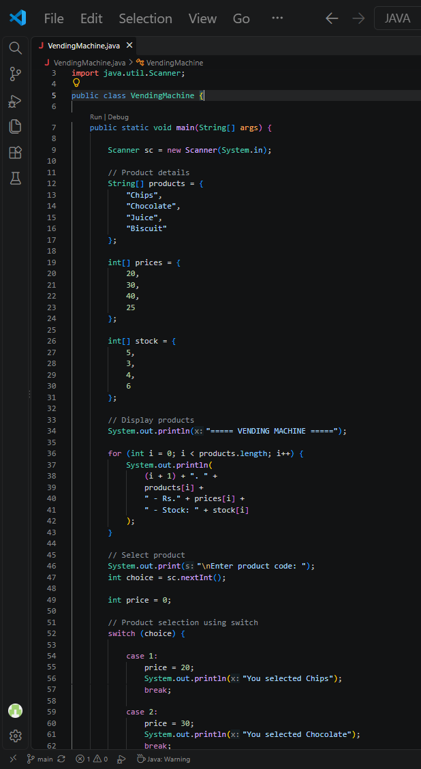
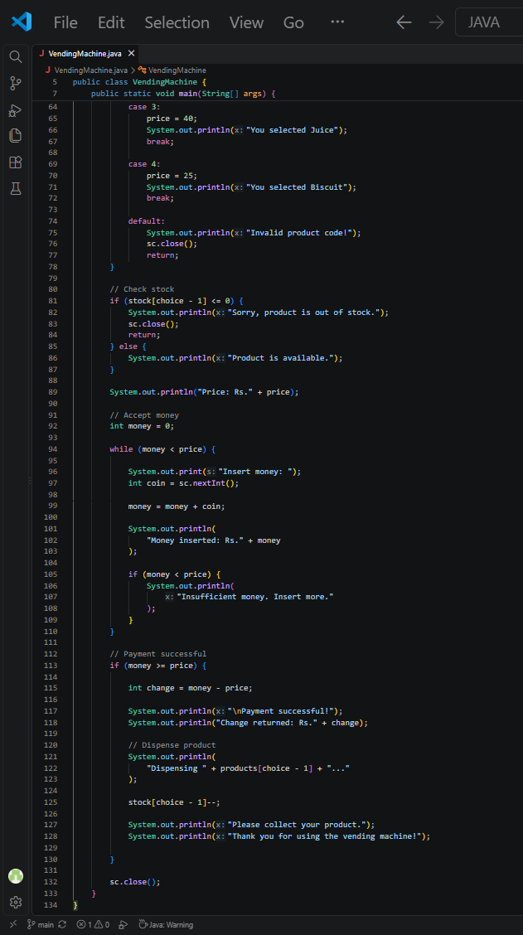
Implementation — Java Code

Slide 10
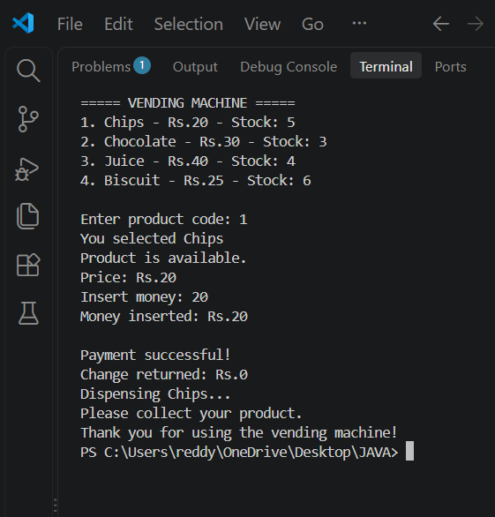
Output Screenshots
USER INTERFACE — SELECTION & PAYMENT
TRANSACTION LOG — DISPENSE & CHANGE

Slide 11


Future Scope
UPI, card and NFC cashless payments
IoT link for remote stock monitoring
Mobile app for pre-ordering items
Sales analytics and demand prediction
Deployment onto real microcontroller hardware
Next

Slide 12
Conclusion
We built a working, state-driven vending machine controller in Java that is accurate, flexible and easy to understand.
Successfully simulated coin handling, selection, dispensing and change.
Demonstrated finite state machine design in a real-world context.
Provides a low-cost platform for learning and testing controller logic.

Slide 13
Thank You

